Slide 1

Journal Club
Beck RW, Riddlesworth TD, Ruedy K, Ahmann A, Haller S, Kruger D, McGill JB, Polonsky W, Price D, Aronoff S, Aronson R, Toschi E, Kollman C, Bergenstal R; DIAMOND Study Group.
Continuous Glucose Monitoring Versus Usual Care in Patients With Type 2 Diabetes Receiving Multiple Daily Insulin Injections: A Randomized Trial.
Ann Intern Med. 2017 Sep 19;167(6):365-374. doi: 10.7326/M16-2855. Epub 2017 Aug 22.
Giugliano RP, Pedersen TR, Park JG, De Ferrari GM, Gaciong ZA, Ceska R, Toth K, Gouni-Berthold I, Lopez-Miranda J, Schiele F, Mach F, Ott BR, Kanevsky E, Pineda AL, Somaratne R, Wasserman SM, Keech AC, Sever PS, Sabatine MS; FOURIER Investigators.
Clinical efficacy and safety of achieving very low LDL-cholesterol concentrations with the PCSK9 inhibitor evolocumab: a prespecified secondary analysis of the FOURIER trial.
Lancet. 2017 Aug 25. pii: S0140-6736(17)32290-0. doi: 10.1016/S0140-6736(17)32290-0.
2017年10月5日 8:30-8:55
８階 医局
埼玉医科大学 総合医療センター 内分泌・糖尿病内科
Department of Endocrinology and Diabetes,
Saitama Medical Center, Saitama Medical University
M5 清水 元治 松井 拓也
Shimizu, Motoharu Matsui, Takuya

Slide 2
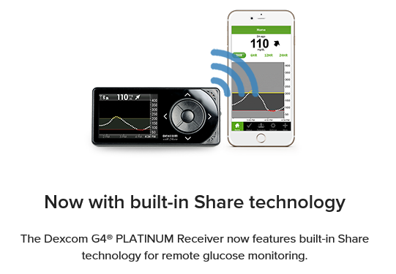
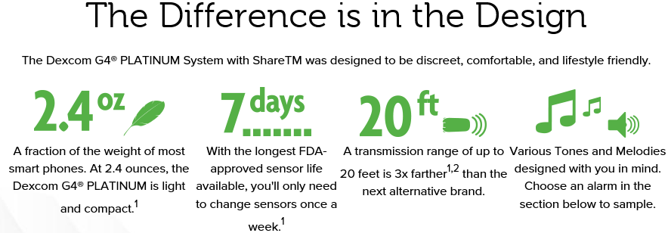
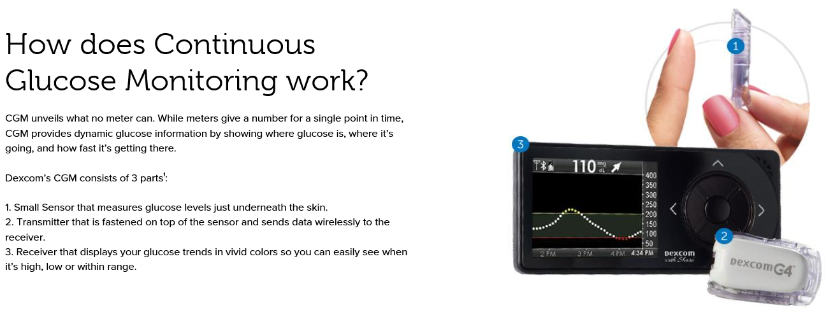
2017/3/16抄読会
https://www.dexcom.com/dexcom-g4-platinum-share
Beck RW et al.: Effect of Continuous Glucose Monitoring on Glycemic Control in Adults With Type 1 Diabetes Using Insulin Injections: The DIAMOND Randomized Clinical Trial. JAMA. 2017 Jan 24;317(4):371-378.

Slide 3
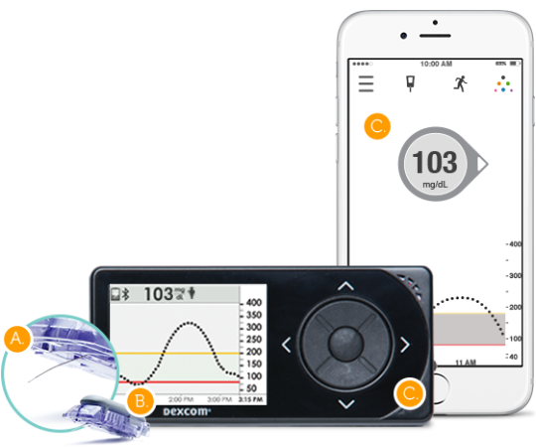
Beck RW et al.: Effect of Continuous Glucose Monitoring on Glycemic Control in Adults With Type 1 Diabetes Using Insulin Injections: The DIAMOND Randomized Clinical Trial. JAMA. 2017 Jan 24;317(4):371-378.
1日に複数回のインスリン注射を行っている1型糖尿病成人患者158例を対象に、持続血糖モニター（CGM）の有効性を無作為化試験で検討（DIAMOND試験）。24週目のHbA1c平均低下率はCGM群が1.0％、通常ケア群が0.4％と、CGM群で有意に大きなHbA1c低下が認められた（HbA1c平均変化量の差：－0.6％、95％CI －0.8％ - －0.3％、P＜0.001）。低血糖（70 mg/dL未満）時間の中央値はCGM群43分/日、通常ケア群80分/日だった（P＝0.002）。
尚、ヨーロッパ(Sweeden)でほぼ同様の研究がされており、GOLD試験と言っている。
日本ではAbbottのlibreが入りつつあるが、DEXCOMの機器もよいらしい。（キャリブレーションが必要だが DEXCOM G5はもっと小さくてキャリブレーション必要ないらしい）
Dexcom G5 Mobile CGM System components
https://www.m3.com/clinical/journal/17337

Slide 4
From Jaeb Center for Health Research, Tampa, Florida; Oregon Health & Science University, Portland, Oregon; Diabetes & Glandular Disease Clinic, San Antonio, Texas; Henry Ford Medical Center, Detroit, Michigan; Washington University in St. Louis, St. Louis, Missouri; Behavioral Diabetes Institute and Dexcom, San Diego, California; Research Institute of Dallas, Dallas, Texas; LMC Diabetes & Endocrinology, Toronto, Ontario, Canada; Joslin Diabetes Center, Boston, Massachusetts; and Park Nicollet International Diabetes Center, St. Louis Park, Minnesota.
Ann Intern Med. 2017 Sep 19;167(6):365-374.

Slide 5
Background:
Continuous glucose monitoring (CGM), which studies have shown is beneficial for adults with type 1 diabetes, has not been well-evaluated in those with type 2 diabetes receiving insulin.
Objective:
To determine the effectiveness of CGM in adults with type 2 diabetes receiving multiple daily injections of insulin.

Slide 6
Design:
Randomized clinical trial. (The protocol also included a type 1 diabetes cohort in a parallel trial and subsequent second trial.) (ClinicalTrials.gov: NCT02282397)
Setting:
25 endocrinology practices in North America.
Patients:
158 adults who had had type 2 diabetes for a median of 17 years (interquartile range, 11 to 23 years). Participants were aged 35 to 79 years (mean, 60 years [SD, 10]), were receiving multiple daily injections of insulin, and had hemoglobin A1c (HbA1c) levels of 7.5% to 9.9% (mean, 8.5%).
Intervention:
Random assignment to CGM (n = 79) or usual care (control group, n = 79).
Measurements:
The primary outcome was HbA1c reduction at 24 weeks.

Slide 7
BMI = body mass index;
CGM = continuous glucose monitoring;
HbA1c = hemoglobin A1c.
* Values are numbers (percentages) unless otherwise stated.
† Missing data for 1 participant from the control group.
‡ Missing data for 1 participant from the CGM group and 5 participants from the control group.
§ Participant was ineligible and should not have been randomly assigned.
Noninsulin medications for CGM group/control group were metformin, 44/41; glucagon-like peptide-1, 11/8; dipeptidyl peptidase-4, 6/4; sodium-glucose cotransporter-2, 15/15; and other, 7/10.
¶ Measured at local laboratories. To convert from ng/mL to nmol/L, multiply values by 0.331.
** Measured with the Clarke Hypoglycemia Unawareness Survey.

Slide 8
The trial was done at 25 endocrinology practices in North America (22 in the United States and 3 in Canada), of which 19 were community-based and 6 were academic centers (4 additional sites screened but did not enroll patients).
Participants in both groups were provided with a Contour Next USB meter (Ascensia Diabetes Care) and test strips. Participants in the CGM group were given a Dexcom G4 Platinum CGM System with an enhanced algorithm (software 505) (Dexcom), which measures glucose concentrations from interstitial fluid in the range of 2.22 to 22.2 mmol/L (40 to 400 mg/dL) every 5 minutes.

Slide 14
Results:
Mean HbA1c levels decreased to 7.7% in the CGM group and 8.0% in the control group at 24 weeks (adjusted difference in mean change, −0.3% [95% CI, −0.5% to 0.0%]; P = 0.022). The groups did not differ meaningfully in CGM-measured hypoglycemia or quality-of-life outcomes. The CGM group averaged 6.7 days (SD, 0.9) of CGM use per week.
Limitation:
6-month follow-up.

Slide 15
Conclusion:
A high percentage of adults who received multiple daily insulin injections for type 2 diabetes used CGM on a daily or near-daily basis for 24 weeks and had improved glycemic control. Because few insulin-treated patients with type 2 diabetes currently use CGM, these results support an additional management method that may benefit these patients.
Primary Funding Source:
Dexcom.

Slide 16
Message
インスリン治療中の2型DMにもCGMは有効
1日に複数回のインスリン注射を行っているHbA1c値7.5-9.9％（平均8.5％）の成人2型糖尿病患者158例を対象に、血糖コントロールにおける持続血糖測定（CGM）の有効性を無作為化試験で検証。24週時のCGM群（79例）のHbA1c平均値は7.7％で、通常ケア群（79例）の8.0％に比べて有意に低かった（調整後の平均変化量の差－0.3％、95％CI －0.5％ - 0.0％、P＝0.022）。
https://www.m3.com/clinical/journal/18144

Slide 18

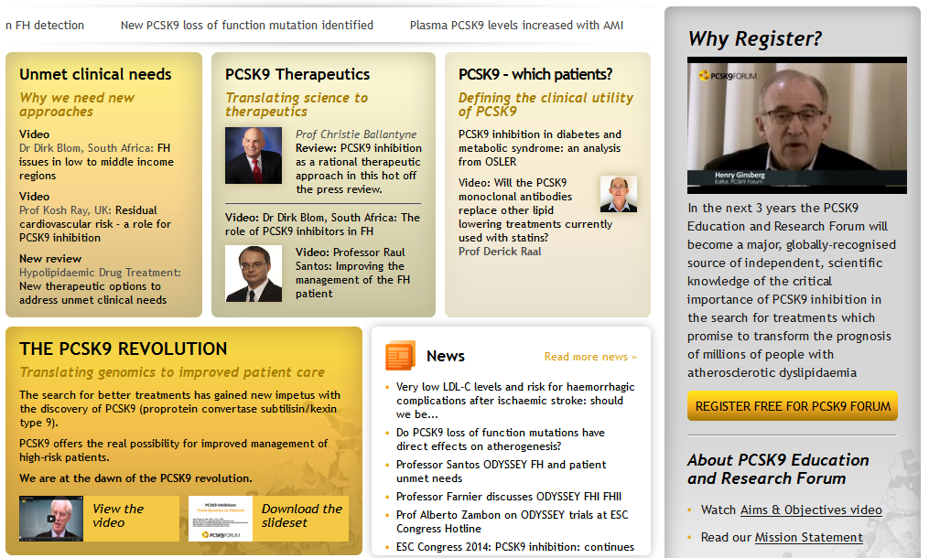
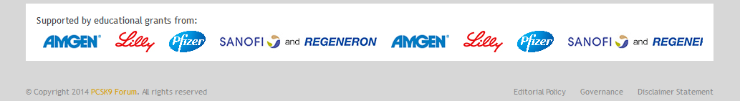
2014/10/23抄読会
http://www.pcsk9forum.org/

Slide 19
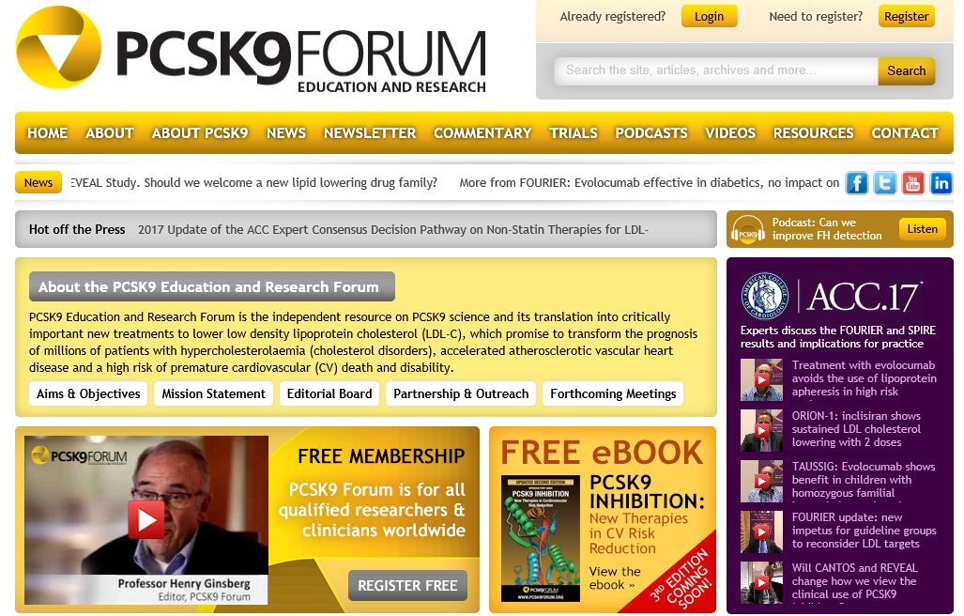
http://www.pcsk9forum.org/

Slide 20
Treatment of homozygous familial hypercholesterolaemia
statins
ezetimibe
partial ileal bypass
portacaval shunt
liver transplantation
LDL apheresis
(mipomersen)
lomitapide
(ALN-PCS)
PCSK9 target
alirocumab
evolocumab
bococizumab
Cf.
Other: HDL-C target
anacetrapib

Slide 21
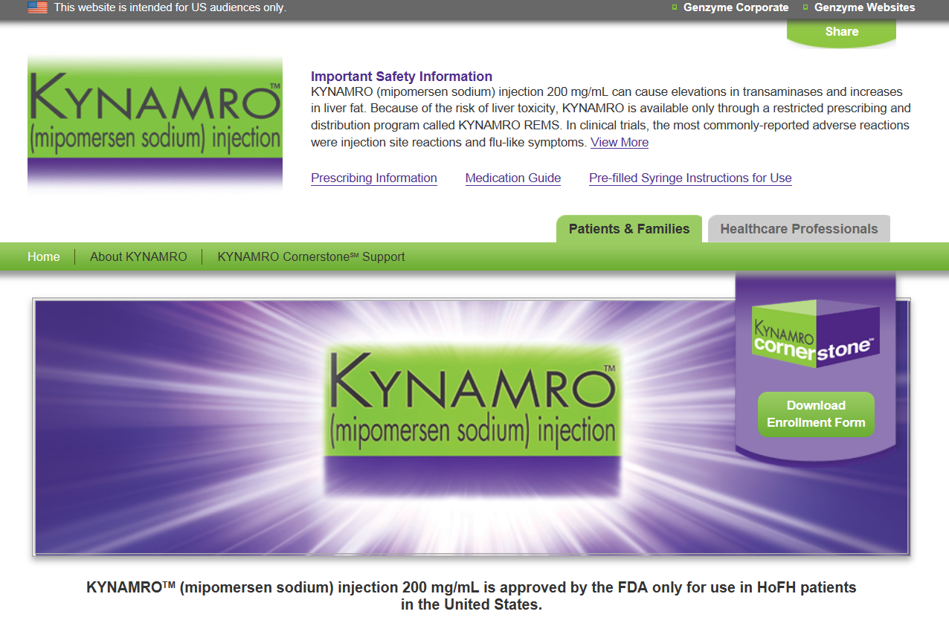
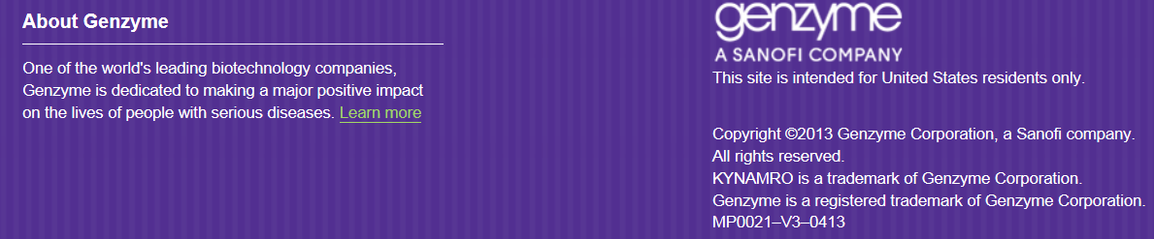
KYNAMROTM (mipomersen sodium)
KYNAMROTM is an oligonucleotide inhibitor of apolipoprotein B-100 synthesis
Lancet 2010; 375: 998–1006

Slide 22
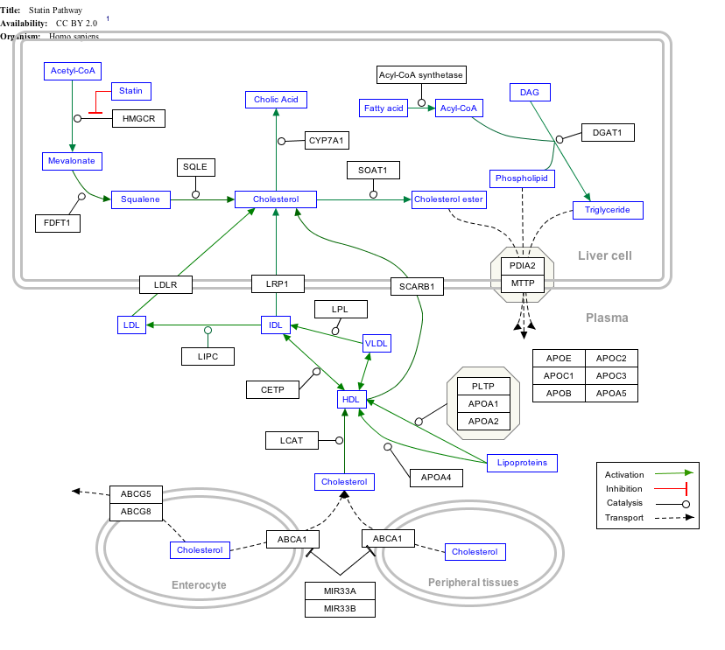
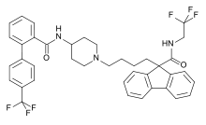
Lomitapide (INN, marketed as Juxtapid) is a drug for the treatment of familial hypercholesterolemia, developed by Aegerion Pharmaceuticals. It has been tested in clinical trials as single treatment and in combinations with atorvastatin, ezetimibe and fenofibrate.
The US Food and Drug Administration (FDA) approved lomitapide on 21 December 2012, as an orphan drug to reduce LDL cholesterol, total cholesterol, apolipoprotein B, and non-high-density lipoprotein (non-HDL) cholesterol in patients with homozygous familial hypercholesterolemia (HoFH).
Lomitapide inhibits the microsomal triglyceride transfer protein (MTP or MTTP) which is necessary for very low-density lipoprotein (VLDL) assembly and secretion in the liver.
http://en.wikipedia.org/wiki/Lomitapide

Slide 23
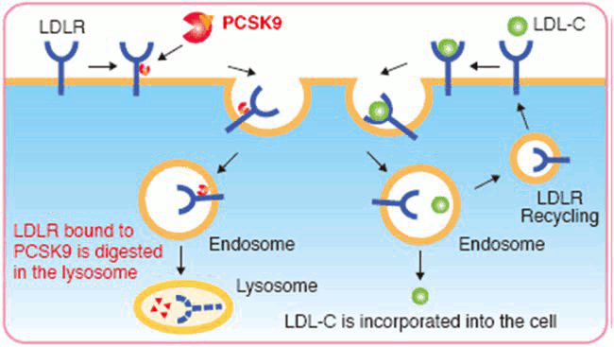
Proprotein convertase subtilisin/kexin type 9
PCSK9 (neural apoptosis-regulated convertase, NARC-1) is a 692-residue extracellular protein representing the 9th member of the secretory subtilase family expressed primarily in the kidneys, liver and intestines.
Genetic studies mapped PCSK9 along with LDLR and APOB to cause autosomal dominant hypercholesterolemia (ADH). Gain-of-function mutations increased plasma levels of low-density lipoprotein cholesterol (LDL-C), whereas nonsense or missense (loss-of-function) mutations, which interfere with folding or secretion of PCSK9, led to a reduction of plasma levels of LDL-C and an 88% decrease in the risk of coronary heart disease (CHD).
http://caltagmedsystems.blogspot.jp/2012/04/pcsk9-attractive-drug-target-for.html

Slide 24
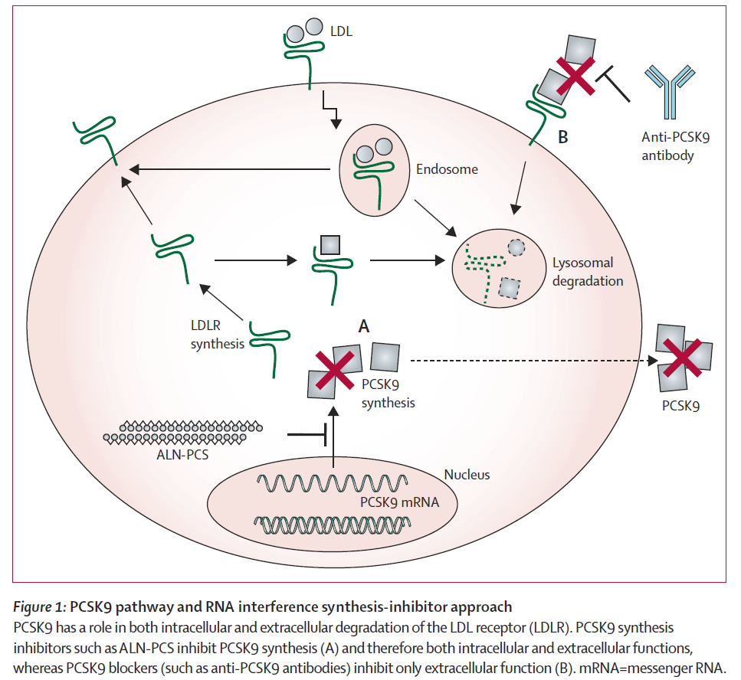
Lancet. 2014 Jan 4;383(9911):60-8.

Slide 25
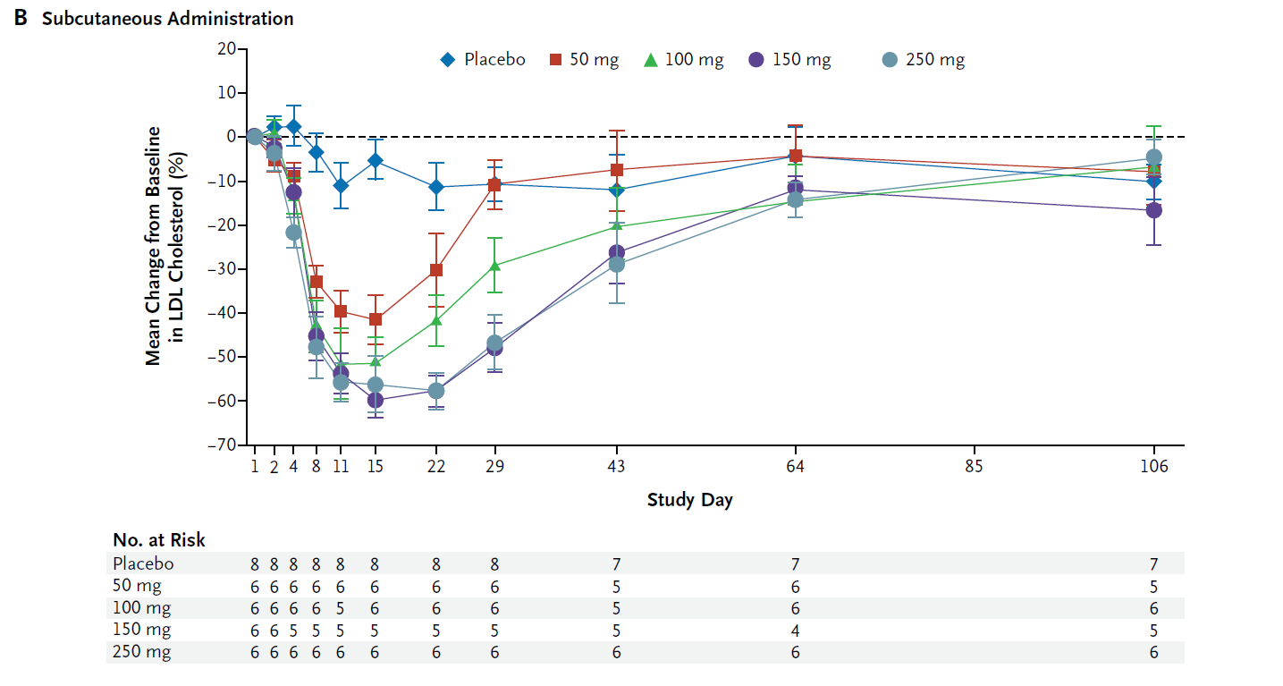
Alirocumab SAR236553 (REGN727)
抗体治療！！
single ascending-dose studies of REGN727
N Engl J Med 2012;366:1108-18.

Slide 26
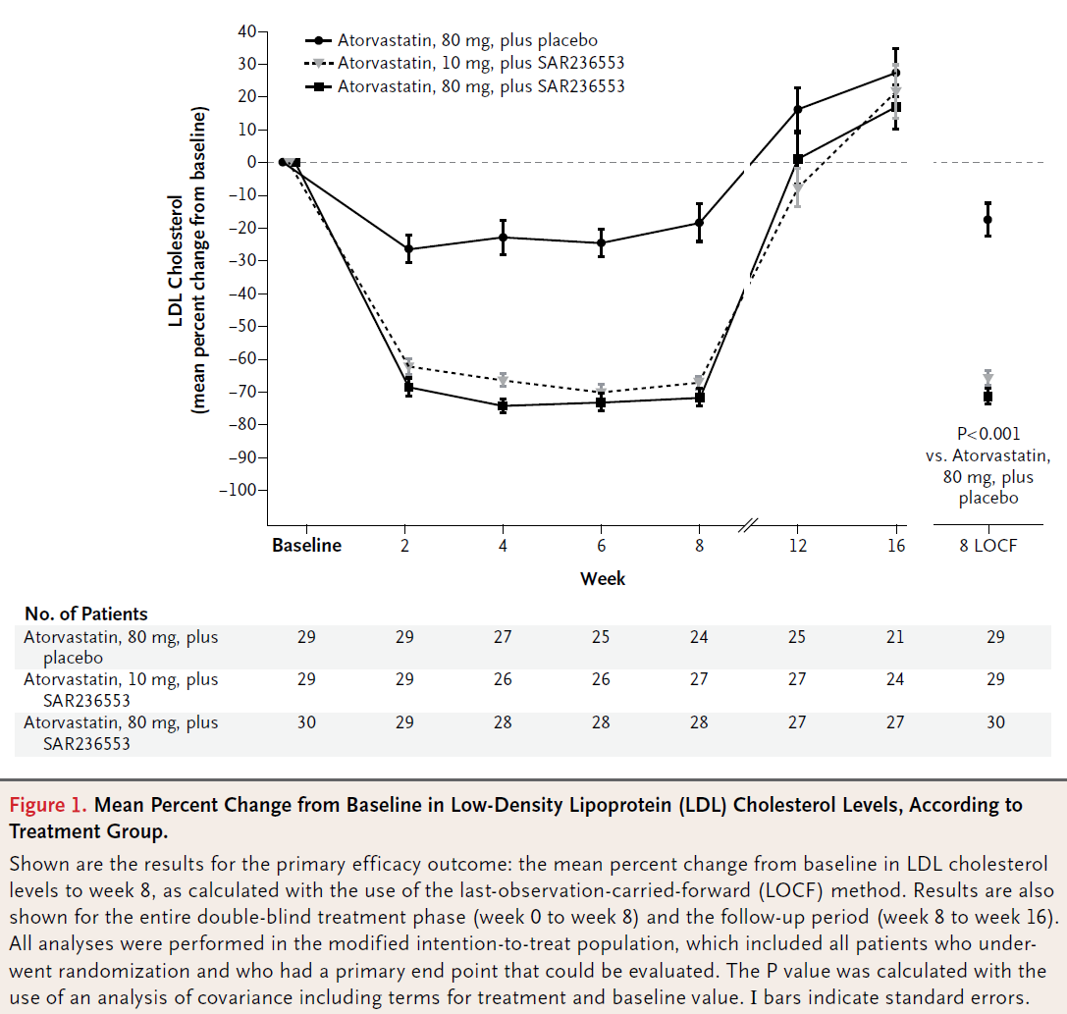
抗体治療+スタチン
Alirocumab SAR236553 (REGN727)
primary hypercholesterolemia
N Engl J Med 2012;367:1891-900. DOI: 10.1056/NEJMoa1201832

Slide 27
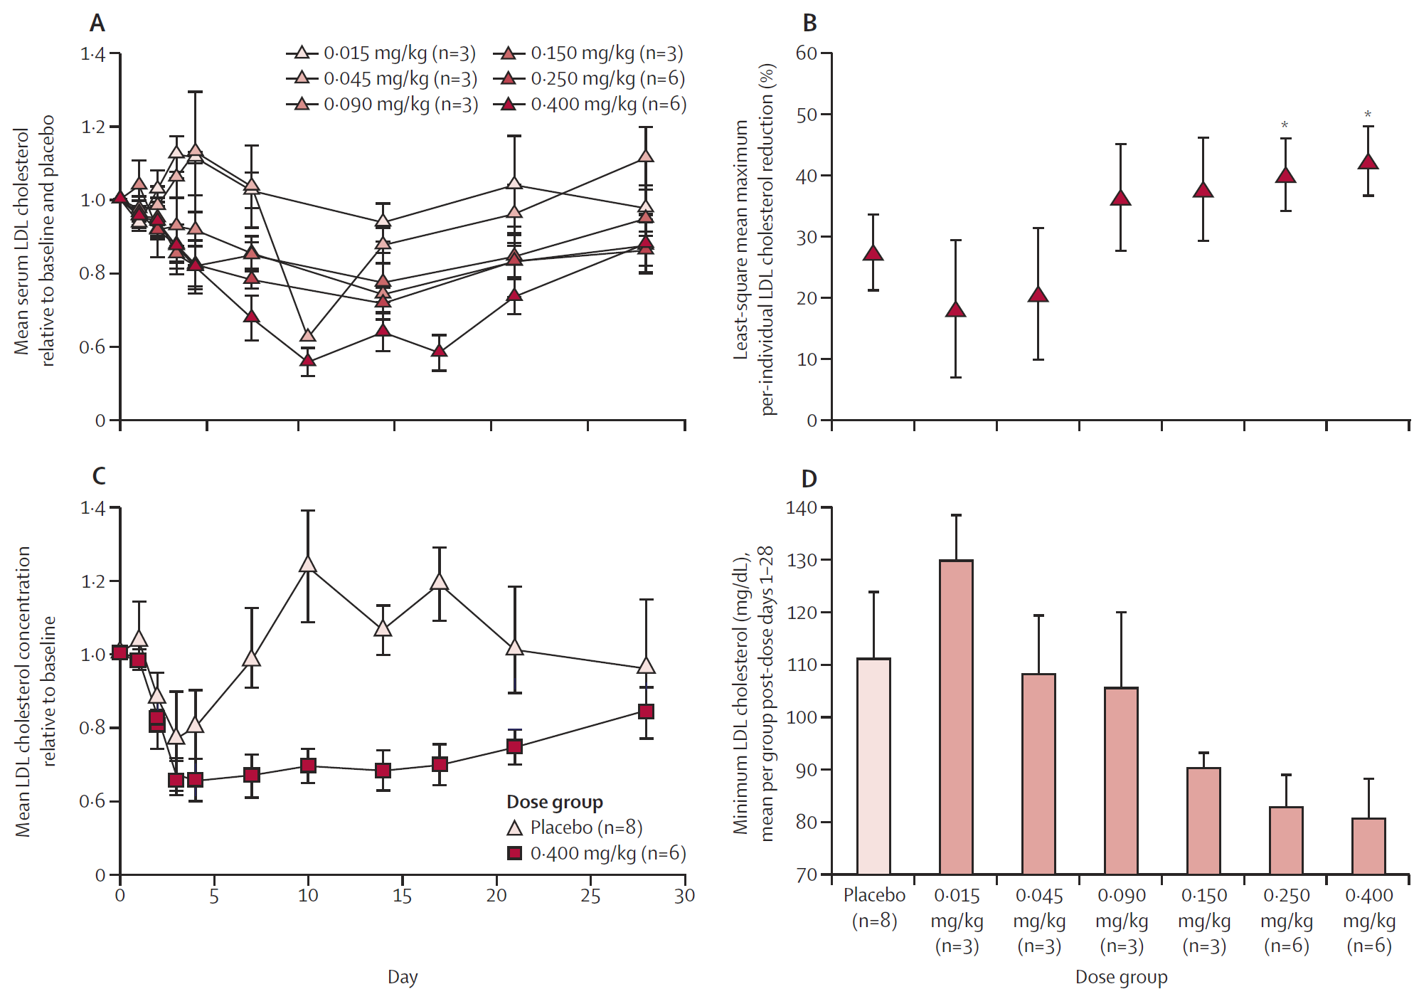
Effect of ALN-PCS treatment on serum LDL cholesterol
Lancet. 2014 Jan 4;383(9911):60-8.
ALN-PCS: a small interfering RNA that inhibits PCSK9 synthesis

Slide 28
Evolocumab (AMG 145)
2014/10/23抄読会
Carbohydrate and Lipid Metabolism Research Unit, Faculty of Health Sciences, University of Witwatersrand, Johannesburg, South Africa (Prof F J Raal PhD); Amgen Inc, One Amgen Center Drive, Thousand Oaks, CA, USA (N Honarpour MD, F Xu MS, R Scott MD, S M Wasserman MD); Division of Lipidology, Department of Medicine, University of Cape Town, UCT Faculty Health Sciences, Cape Town, South Africa (D J Blom MD); Vascular Medicine, Academic Medical Centre, Amsterdam, Netherlands (G Kees Hovingh MD); and Metabolic and Atherosclerosis Research Center, Cincinnati, OH, USA (Prof E A Stein PhD)
www.thelancet.com Published online October 2, 2014 http://dx.doi.org/10.1016/S0140-6736(14)61374-X

Slide 30
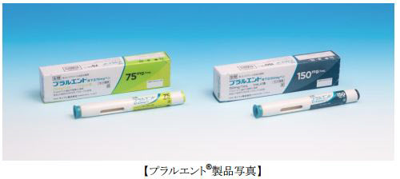
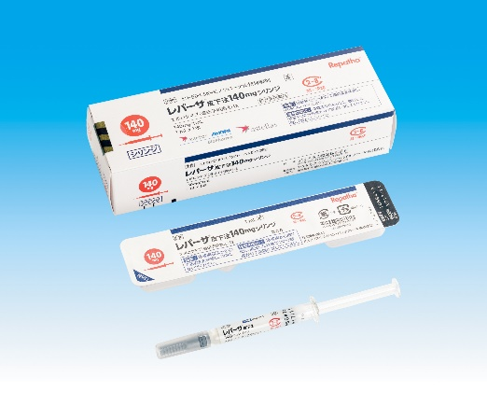
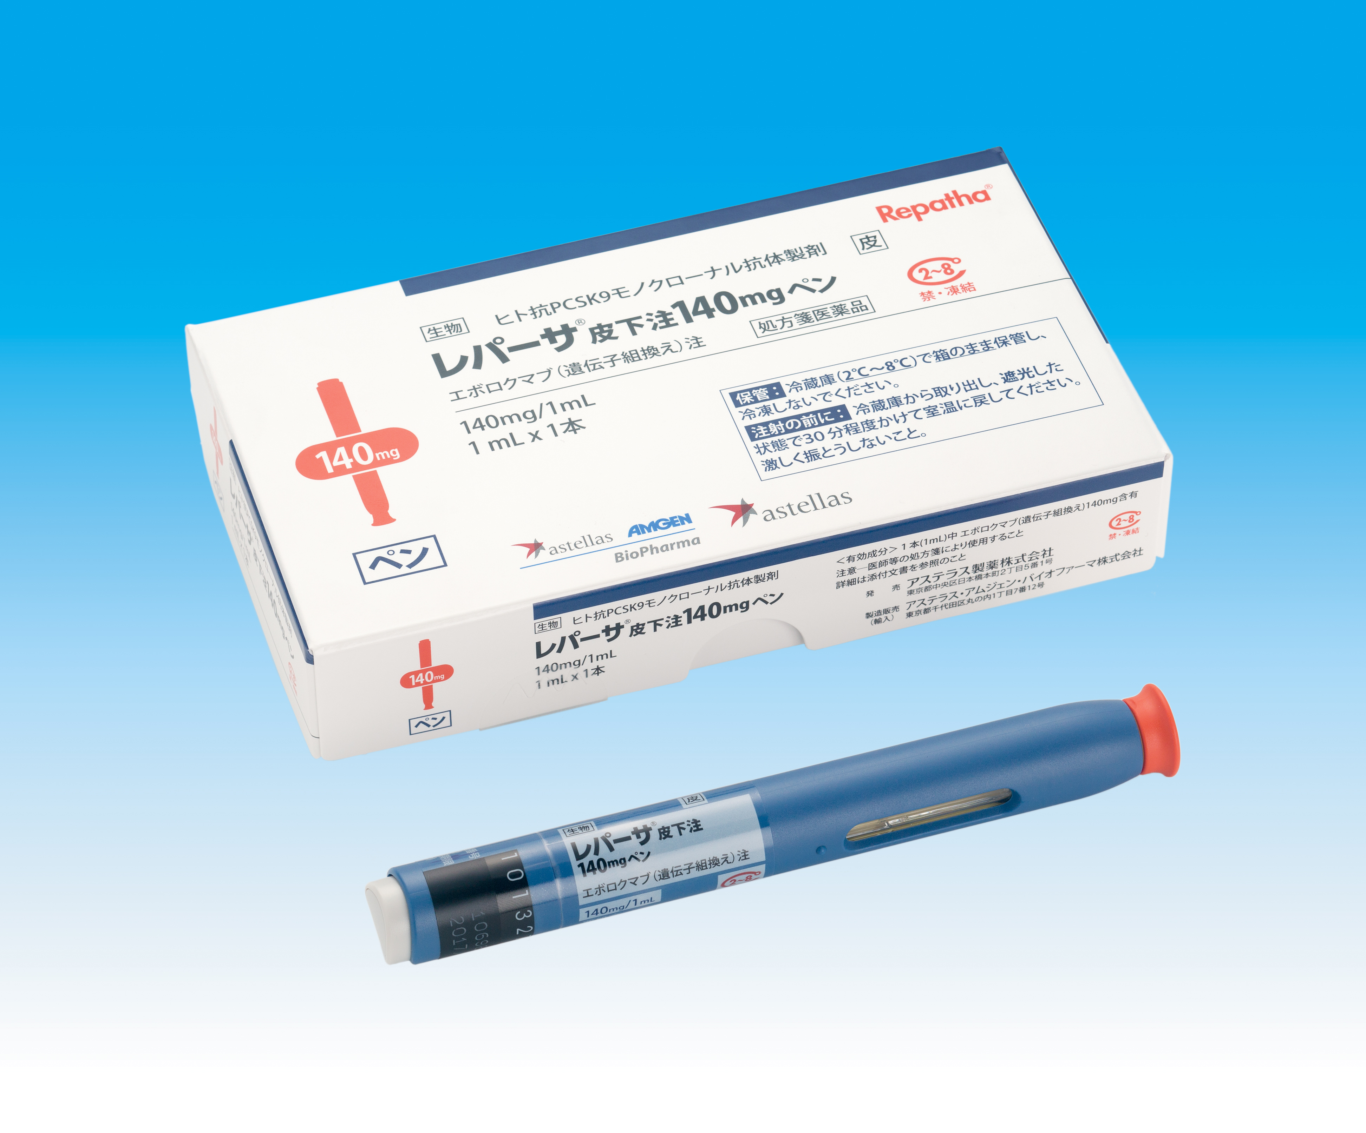
Alirocumab
Evolocumab
(Wikipedia)
【レパーサ®製品写真】
アリロクマブはIgG1アイソタイプに分類されるヒトモノクローナル抗体である。ジスルフィド結合で連結された2本のヒト抗体重鎖と、それぞれの重鎖にジスルフィド結合で結ばれたヒト抗体軽鎖から成り、分子量はおよそ146kDaである。
チャイニーズハムスターの卵巣細胞に組み換えDNAを導入してタンクで培養して作製している。
米国では2014年8月に生物学的製剤承認申請書(BLA)が提出され、2015年8月に既存の治療で効果不充分な患者についての使用が承認された。
欧州では2014年9月に医薬品販売承認申請(MAA)が提出され、2015年7月に承認された。
日本では2015年3月に製造承認申請され、2016年1月に承認された。
米国での承認日は2015年7月であり、エボロクマブよりも早く、米国で初めてのPCSK9阻害薬（英語版）となった。米国食品医薬品局（FDA）の承認は、さらなる臨床試験を完了させて有効性と安全性を確認する事、という条件付きであった。商品名プラルエント。開発コード：REGN727およびSAR236553。
レパーサ®皮下注 140mgシリンジ： 22,948円
通常、成人にはエボロクマブ（遺伝子組換え）として140mgを2週間に1回又は420mgを4週間に1回皮下投与する。
家族性高コレステロール血症ホモ接合体では420mgを4週間に1回皮下投与効果不十分な場合には420mgを2週間に1回皮下投与できる。
2014年7月、リジェネロン社とサノフィ社は、FDAから6,750万米ドルで優先審査権（英語版）を購入
プラルエント®皮下注75mgペン 22,948円
プラルエント®皮下注150mgペン 44,481円
プラルエント®皮下注75mgシリンジ 22,948円
プラルエント®皮下注150mgシリンジ 44,481円
通常、成人にはアリロクマブ（遺伝子組換え）として75mgを2週に1回皮下投与する。効果不十分な場合には1回150mgに増量できる。
2016年 9 月 1 日付で処方せんを交付することができる注射薬および「在宅自己注射指導管理料」が算定できる注射薬として、官報告示された。

Slide 31
大規模臨床治験中(心血管障害リスク者)
ODYSSEY (NCT01663402) with alirocumab,
FOURIER (NCT01764633) with evolocumab, and
SPIRE-1 (NCT01975389) and SPIRE-2 (NCT01975376) with bococizumab,
ファイザーが開発を中止

Slide 32
Ann Intern Med. 2015 Jul 7;163(1):40-51. doi: 10.7326/M14-2957.

Slide 33
Ann Intern Med. 2015 Jul 7;163(1):40-51. doi: 10.7326/M14-2957.

Slide 34
the Further Cardiovascular Outcomes Research with PCSK9 Inhibition in Subjects with Elevated Risk (FOURIER)
N Engl J Med 2017;376:1713-22.

Slide 35
TIMI Study Group, Division of Cardiovascular Medicine, Brigham and Women’s Hospital, Boston, MA, USA (R P Giugliano MD, J-Gun Park PhD, E Kanevsky MS, Prof M S Sabatine MD); Oslo University Hospital, Ullevål and Medical Faculty, University of Oslo, Oslo, Norway (Prof T R Pedersen MD); Department of Molecular Medicine, University of Pavia and Cardiac Intensive Care Unit and Laboratories for Experimental Cardiology, IRCCS Fondazione Policlinico San Matteo, Pavia, Italy (G M De Ferrari MD); Department of Internal Medicine, Hypertension and Vascular Diseases, The Medical University of Warsaw, Warsaw, Poland (Prof Z A Gaciong MD); Center of Preventive Cardiology, 3rd Department Internal Medicine, University General Hospital and 1st Medical Faculty, Prague, Czech Republic (Prof R Ceska MD); 1st Department of Medicine, University of Pécs, Pécs, Hungary (Prof K Toth MD); Polyclinic for Endocrinology, Diabetes, and Preventive Medicine, University of Cologne, Cologne, Germany (Prof I Gouni-Berthold MD); Lipids and Atherosclerosis Unit, Maimonides Biomedical Research Institute of Cordoba, Reina Sofia University Hospital, University of Cordoba, CIBEROBN, Cordoba, Spain (Prof J Lopez-Miranda MD); University Hospital Center Besançon, Besançon, France (Prof F Schiele MD); Hopital Cantonal, Hopitaux Universitaires de Geneva, Geneva, Switzerland (Prof F Mach MD); Rhode Island Hospital, Department of Neurology, Alpert Medical School of Brown University, Providence, RI, USA (Prof B R Ott MD); Amgen, Thousand Oaks, CA, USA (A Lira Pineda MD, R Somaratne MD, S M Wasserman MD); Sydney Medical School, National Health and Medical Research Council Clinical Trials Centre, University of Sydney, Sydney, NSW, Australia (Prof A C Keech FRACP); and International Centre for Circulatory Health, National Heart and Lung Institute, Imperial College London, London, UK (Prof P S Sever FRCP)
Lancet. 2017 Aug 25. pii: S0140-6736(17)32290-0. doi: 10.1016/S0140-6736(17)32290-0.

Slide 36
Background
LDL cholesterol is a well established risk factor for atherosclerotic cardiovascular disease. How much one should or safely can lower this risk factor remains debated. We aimed to explore the relationship between progressively lower LDL-cholesterol concentrations achieved at 4 weeks and clinical efficacy and safety in the FOURIER trial of evolocumab, a monoclonal antibody to proprotein convertase subtilisin-kexin type 9 (PCSK9).

Slide 37
Methods
In this prespecified secondary analysis of 25 982 patients from the randomised FOURIER trial, the relationship between achieved LDL-cholesterol concentration at 4 weeks and subsequent cardiovascular outcomes (primary endpoint was the composite of cardiovascular death, myocardial infarction, stroke, coronary revascularisation, or unstable angina; key secondary endpoint was the composite of cardiovascular death, myocardial infarction, or stroke) and ten prespecified safety events of interest was examined over a median of 2·2 years of follow-up. We used multivariable modelling to adjust for baseline factors associated with achieved LDL cholesterol.
This trial is registered with ClinicalTrials.gov, number NCT01764633.

Slide 38
Patients were randomly assigned (1:1) either subcutaneous evolocumab (either 140 mg every 2 weeks or 420 mg once per month, per patient preference) or matching placebo injections, and were followed up for a median of 2·2 years (IQR 1·8–2·5 years).
LDL cholesterol was calculated based on the Friedewald equation, unless the calculated value was less than 1·03 mmol/L (40 mg/dL) or the measured triglycerides were higher than 4·52 mmol/L (400 mg/dL), in which case a direct measurement using ultracentrifugation was done.
TIMI risk score: The Thrombolysis in Myocardial Infarction (TIMI) Score is used to determine the likelihood of ischemic events or mortality in patients with unstable angina or non–ST-segment elevation myocardial infarction (NSTEMI).
http://emedicine.medscape.com/article/2172627-overview

Slide 41
<20 mgdL 20 to <50 mg/dL 50 to <70 mg/dL 70 to <100 mg/dL ≥100mg/dL
81 93 85 89 116
154 166 162 162 193
42 42 42 42 46
133 133 142 124 142

Slide 42
0 19 39 58 77 97 116 135 154 174
LDL-cholesterol concentration at 4 weeks after randomization (mg/dL)
Figure 3: Relationship between the achieved LDL-cholesterol concentration at 4 weeks and the risk of the primary (A) and key secondary (B) efficacy composite endpoints
The primary efficacy endpoint was a composite of cardiovascular death, myocardial infarction, stroke, coronary revascularisation, or hospital admission for unstable angina. The key secondary efficacy endpoint was a composite of cardiovascular death, myocardial infarction, or stroke. The red line represents the adjusted probability of an event and blue areas are the 95% CIs of the regression model estimate.

Slide 43
0 19 39 58 77 97 116 135 154 174
LDL-cholesterol concentration at 4 weeks after randomization (mg/dL)
Figure 3: Relationship between the achieved LDL-cholesterol concentration at 4 weeks and the risk of the primary (A) and key secondary (B) efficacy composite endpoints
The primary efficacy endpoint was a composite of cardiovascular death, myocardial infarction, stroke, coronary revascularisation, or hospital admission for unstable angina. The key secondary efficacy endpoint was a composite of cardiovascular death, myocardial infarction, or stroke. The red line represents the adjusted probability of an event and blue areas are the 95% CIs of the regression model estimate.

Slide 44
<20 mgdL 20 to <50 mg/dL 50 to <70 mg/dL 70 to <100 mg/dL ≥100mg/dL

Slide 45
Findings
Between Feb 8, 2013, and June 5, 2015, 27 564 patients were randomly assigned a treatment in the FOURIER study. 1025 (4%) patients did not have an LDL cholesterol measured at 4 weeks and 557 (2%) had already had a primary endpoint event or one of the ten prespecified safety events before the week-4 visit. From the remaining 25 982 patients (94% of those randomly assigned) 13 013 were assigned evolocumab and 12 969 were assigned placebo. 2669 (10%) of 25 982 patients achieved LDL-cholesterol concentrations of less than 0·5 mmol/L, 8003 (31%) patients achieved concentrations between 0·5 and less than 1·3 mmol/L, 3444 (13%) patients achieved concentrations between 1·3 and less than 1·8 mmol/L, 7471 (29%) patients achieved concentrations between 1·8 to less than 2·6 mmol/L, and 4395 (17%) patients achieved concentrations of 2·6 mmol/L or higher. There was a highly significant monotonic relationship between low LDL-cholesterol concentrations and lower risk of the primary and secondary efficacy composite endpoints extending to the bottom first percentile (LDL-cholesterol concentrations of less than 0·2 mmol/L; p=0·0012 for the primary endpoint, p=0·0001 for the secondary endpoint). Conversely, no significant association was observed between achieved LDL cholesterol and safety outcomes, either for all serious adverse events or any of the other nine prespecified safety events.

Slide 46
Interpretation
There was a monotonic relationship between achieved LDL cholesterol and major cardiovascular outcomes down to LDL-cholesterol concentrations of less than 0·2 mmol/L(8mg/dL). Conversely, there were no safety concerns with very low LDL-cholesterol concentrations over a median of 2·2 years. These data support further LDL-cholesterol lowering in patients with cardiovascular disease to well below current recommendations.
Funding
Amgen.

Slide 47
Message
LDL-Cと心血管転帰の関連は単調、FOURIER試験
PCSK9阻害薬エボロクマブを評価したFOURIER試験の二次解析で、LDL-C低下と心血管転帰との関連を検証。アテローム動脈硬化性心血管疾患患者2万5982例を対象とした。対象の10%で0.5 mmol/L未満、31%で0.5 - 1.30 mmol/L未満、13%で1.3 - 1.8 mmol/L未満、29%で1.8 - 2.6 mmol/L未満、17%で2.6 mmol/L以上のLDL-C値低下が達成された。第1四分位の最小値（0.2 mmol/L未満）を含め、全体としてLDL-Cと主要心血管転帰との間に単調関係が見られた。
https://www.m3.com/clinical/journal/18143

